Slide 1
Lecture 06 - Image Descriptors
Prof. André Gustavo Hochuli
gustavo.hochuli@pucpr.br
aghochuli@ppgia.pucpr.br
Notes:
Prof. André Hochuli

Slide 2
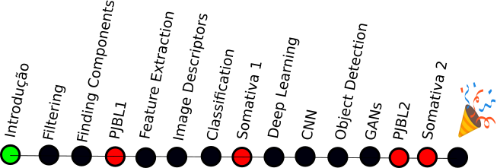
Topics
Discussion of Lecture #05
Feature Vector
Horizontal and Vertical Projections
Image Descriptors
Practice
Computer Vision - Prof. André Hochuli
Lecture 06
Notes:
Prof. André Hochuli

Slide 3
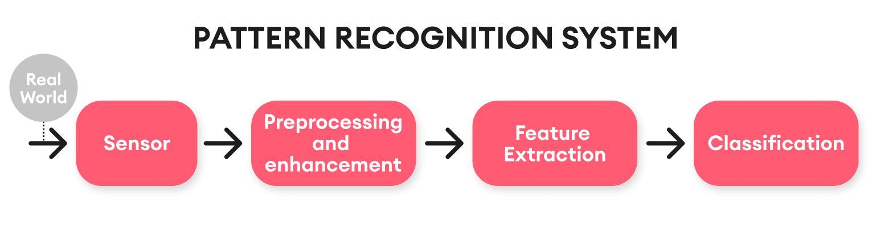
Computer Vision & Pattern Recognition Pipeline
Computer Vision - Prof. André Hochuli
Lecture 06
Notes:
Prof. André Hochuli

Slide 4
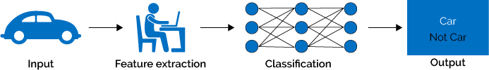
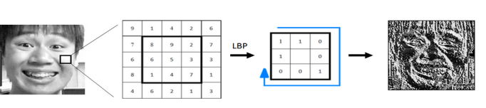
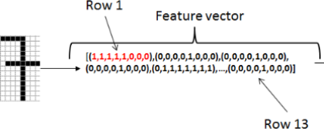
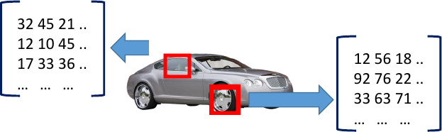
Remembering….
A feature descriptor translates high-dimensional data to a feature space
A feature vector represents the input data produced by the feature descriptor
Later, a machine learning model will learn the representations
Computer Vision - Prof. André Hochuli
Lecture 06
Notes:
Prof. André Hochuli

Slide 5
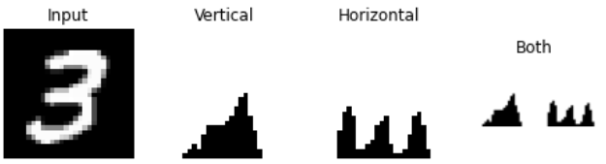
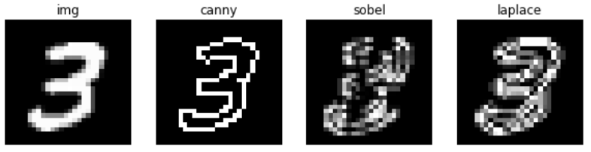
Image Descriptors – Shape / Edges
Gradient Based
Projections
Convolutional (Filters)
Computer Vision - Prof. André Hochuli
Lecture 06
Notes:
Prof. André Hochuli

Slide 6
Image Descriptors – Shape / Edges
Gradient Based
Projections
Convolutional (Filters)
Computer Vision - Prof. André Hochuli
Lecture 06
Notes:
Prof. André Hochuli

Slide 7
Image Descriptors – Shape / Edges
Gradient Based
Projections
Convolutional (Filters)
Computer Vision - Prof. André Hochuli
Lecture 06
Notes:
Prof. André Hochuli

Slide 8
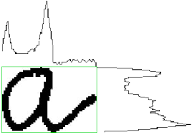
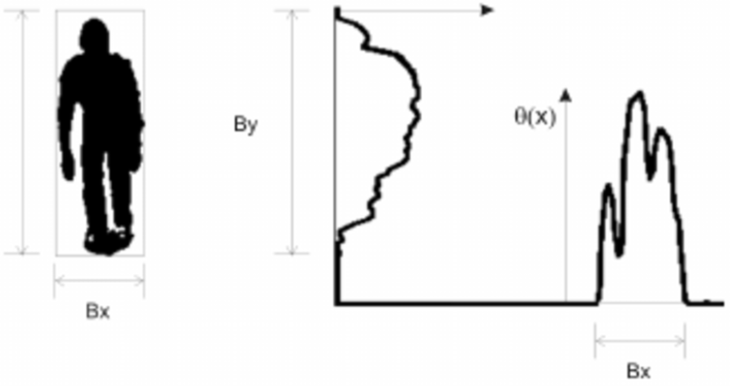
Image Descriptors – Shape / Edges
Histogram Projection
Computer Vision - Prof. André Hochuli
Lecture 06
Notes:
Prof. André Hochuli

Slide 9
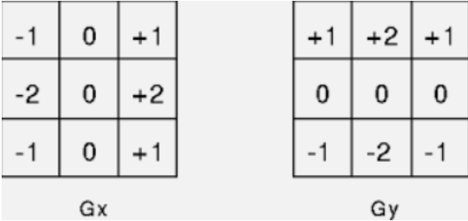
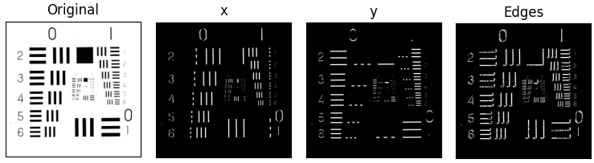
Image Descriptors – Shape / Edges
Sobel Filter
Computer Vision - Prof. André Hochuli
Lecture 06
Notes:
Prof. André Hochuli

Slide 10
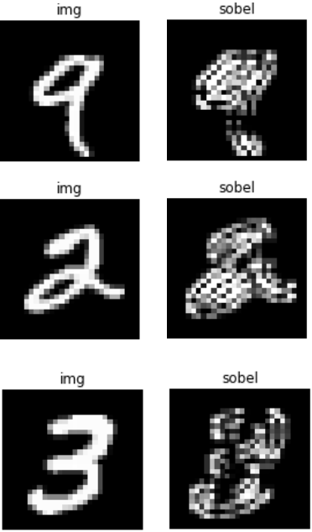
Image Descriptors – Shape / Edges
Sobel Filter
Computer Vision - Prof. André Hochuli
Lecture 06
Notes:
Prof. André Hochuli

Slide 11
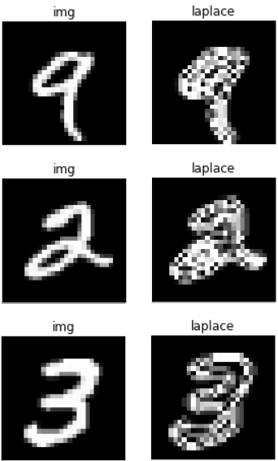
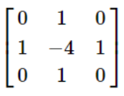
Image Descriptors – Shape / Edges
Laplace
Computer Vision - Prof. André Hochuli
Lecture 06
Notes:
Prof. André Hochuli

Slide 12
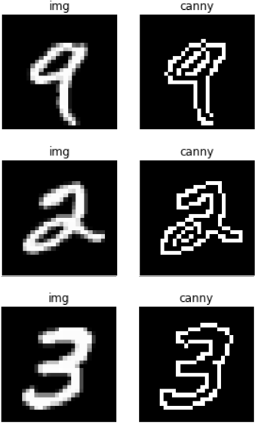
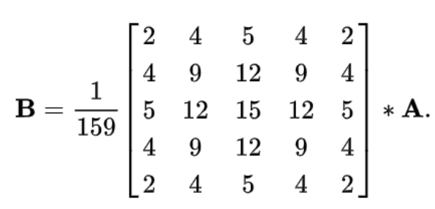
Image Descriptors – Shape / Edges
Canny
Gaussian Gradient Based Filter (John F. Canny 1986)
Computer Vision - Prof. André Hochuli
Lecture 06
Notes:
Prof. André Hochuli

Slide 13
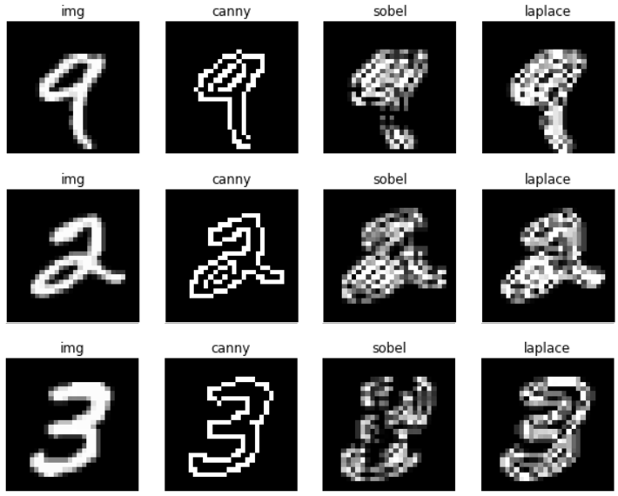
Image Descriptors – Shape / Edges
Computer Vision - Prof. André Hochuli
Lecture 06
Notes:
Prof. André Hochuli

Slide 14
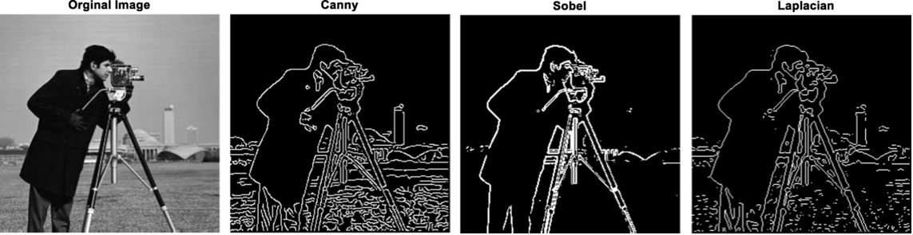
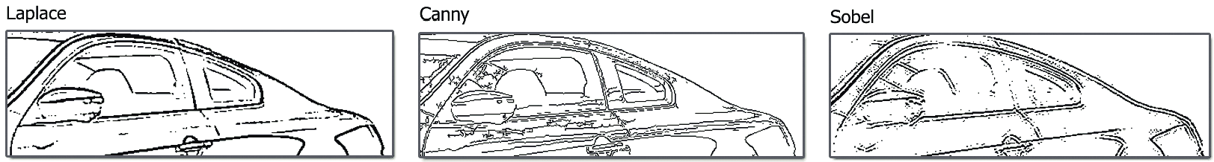
Image Descriptors – Shape / Edges
Computer Vision - Prof. André Hochuli
Lecture 06
Notes:
Prof. André Hochuli

Slide 15
Let’s Code
LINK
Computer Vision - Prof. André Hochuli
Lecture 06
Notes:
Prof. André Hochuli

